Slide 1

Sensitivity Analysis: with Lagrange Multipliers
MTH 564 – Mathematical Modeling

Slide 2
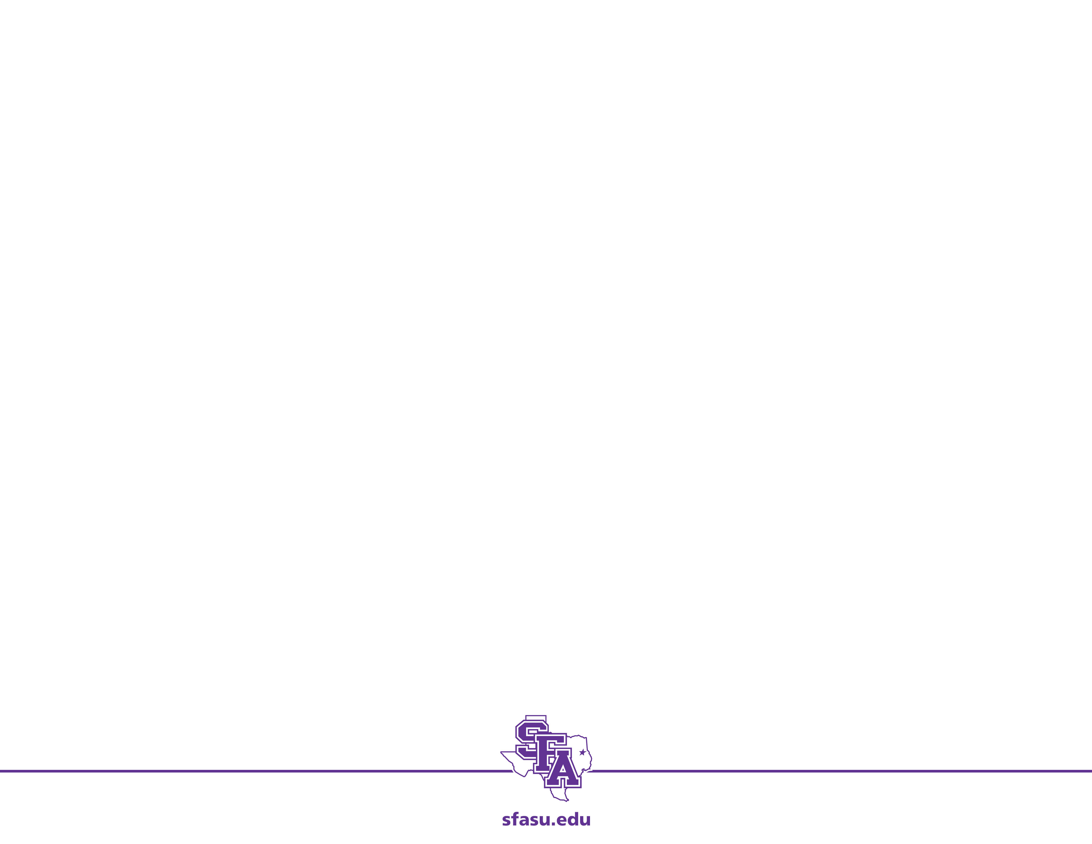
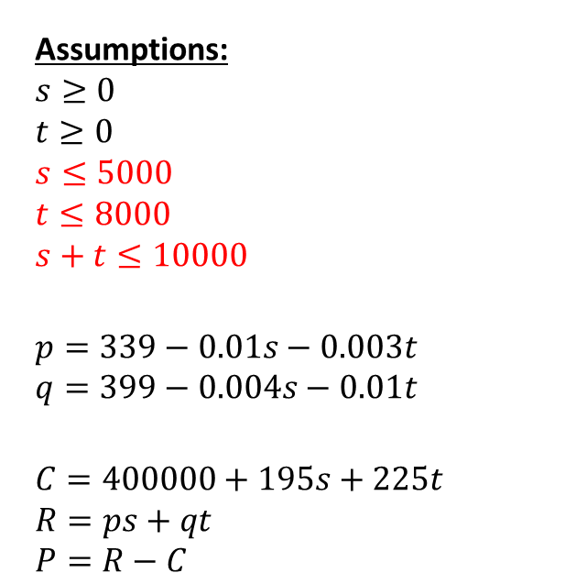
The Model
Assumptions:
$$s≥0$$
$$t≥0$$
$$s≤5000$$
$$t≤8000$$
$$s+t≤10000$$
$$p=339−0.01s−0.003t$$
$$q=399−0.004s−0.01t$$
$$C=400000+195s+225t \\ R=ps+qt \\ P=R−C$$
Parameters (Price Elasticity):
$0.01 – amount of price drop per unit sold
$0.003 – amount of price drop for 19-inch set for each 21-inch sold
$0.004 – amount of price drop for 21-inch set for each 19-inch sold
Parameters (Constraints):
5000 – max number of 19 inch sets
8000 – max number of 21 inch sets
10000 – combine max number of TV sets that can be produced.
Maximize:

Slide 3
Price Elasticity of 19-inch set
Parameters:
a – amount of price drop for 19-inch set for each 19-inch set sold
$0.01 – amount of price drop for 21-inch set for each 21-inch set sold
$0.003 – amount of price drop for 19-inch set for each 21-inch set sold
$0.004 – amount of price drop for 21-inch set for each 19-inch set sold
We will per form sensitivity analysis on the amount of price drop for a 19-inch set for each 19-inch set sold, calling this parameter a.
We now examine how this changes the model, again using Lagrange multipliers.

Slide 4
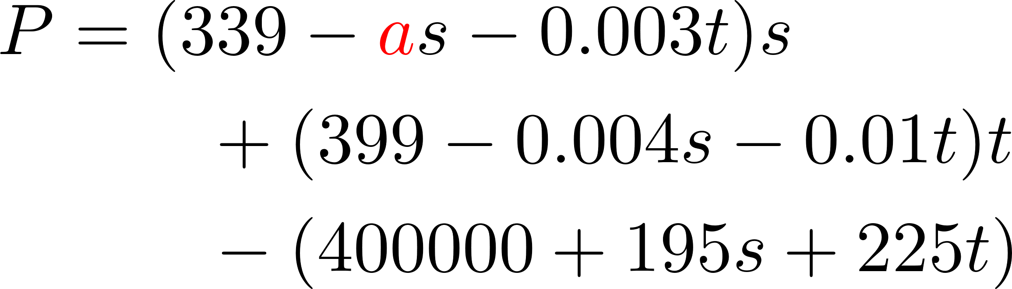
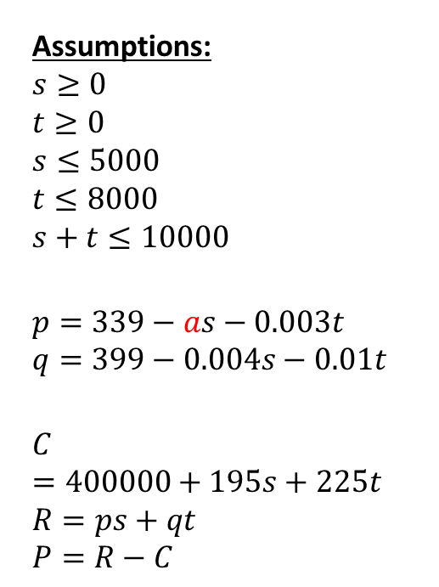
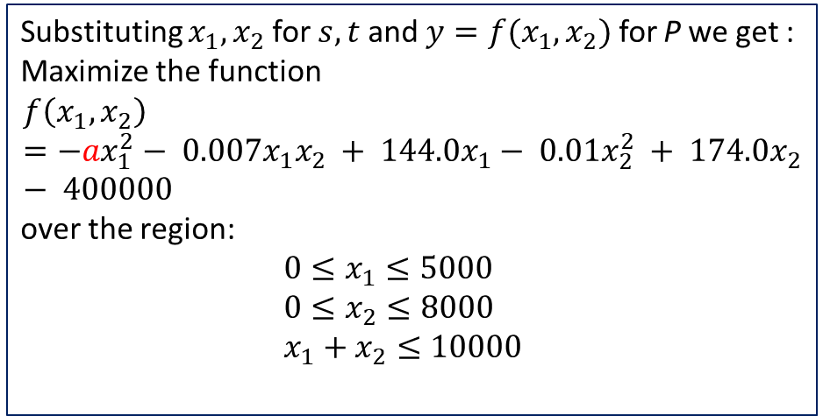
Updated Model
Assumptions:
$$s≥0$$
$$t≥0$$
$$s≤5000$$
$$t≤8000$$
$$s+t≤10000$$
$$p=339−as−0.003t$$
$$q=399−0.004s−0.01t$$
$$C=400000+195s+225t \\ R=ps+qt \\ P=R−C$$
Maximize:
Substituting $x_{1},x_{2}$ for $s,t$ and ${y=f(x}_{1},x_{2})$ for P we get : Maximize the function
$$f\left(x_{1},x_{2}\right)=−ax_{1}^{2}− 0.007x_{1}x_{2} + 144.0x_{1}− 0.01x_{2}^{2} + 174.0x_{2}− 400000$$
over the region:
$0≤x_{1}≤5000$
$0≤x_{2}≤8000$
$x_{1}+x_{2}≤10000$

Slide 5
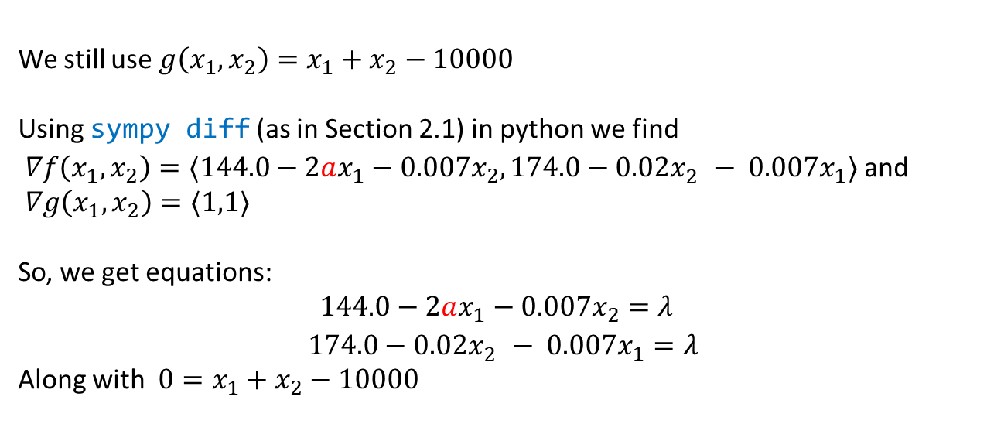
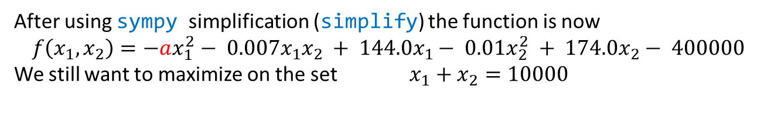
Reexamining Calculations
After using sympy simplification (simplify) the function is now
$$f\left(x_{1},x_{2}\right)=−ax_{1}^{2}− 0.007x_{1}x_{2} + 144.0x_{1}− 0.01x_{2}^{2} + 174.0x_{2}− 400000$$
We still want to maximize on the set $x_{1}+x_{2}=10000$
We still use ${g\left(x_{1},x_{2}\right)=x}_{1}+x_{2}−10000$
Using sympy diff (as in Section 2.1) in python we find
$∇f\left(x_{1},x_{2}\right)=〈144.0−2ax_{1}−0.007x_{2},174.0−0.02x_{2}^{}− 0.007x_{1}〉$ and
$∇g\left(x_{1},x_{2}\right)=〈1,1〉$
So, we get equations:
$$144.0−2ax_{1}−0.007x_{2}=λ$$
$174.0−0.02x_{2}^{}− 0.007x_{1}=λ$
Along with ${0=x}_{1}+x_{2}−10000$

Slide 6
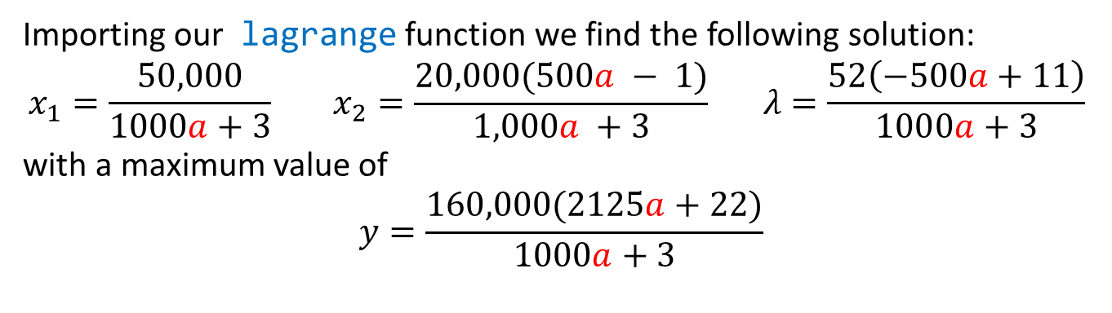
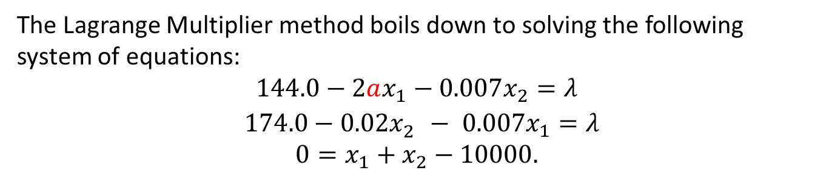
Reexamining Calculations: Lagrange
The Lagrange Multiplier method boils down to solving the following system of equations:
$$144.0−2ax_{1}−0.007x_{2}=λ$$
$174.0−0.02x_{2}^{}− 0.007x_{1}=λ$
$${0=x}_{1}+x_{2}−10000.$$
Importing our lagrange function we find the following solution:
$$x_{1}=\frac{50,000}{1000a+3} x_{2}=\frac{20,000(500a − 1)}{1,000a +3} λ=\frac{52\left(−500a+11\right)}{1000a+3}$$
with a maximum value of
$$y=\frac{160,000(2125a+22)}{1000a+3}$$
Notes:
Note the use of nsymplify and simplify. The nsimplify makes all the numbers fractions, which can produce better results.

Slide 7
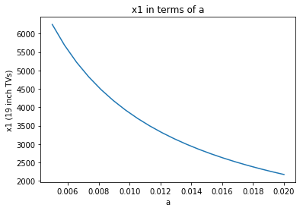
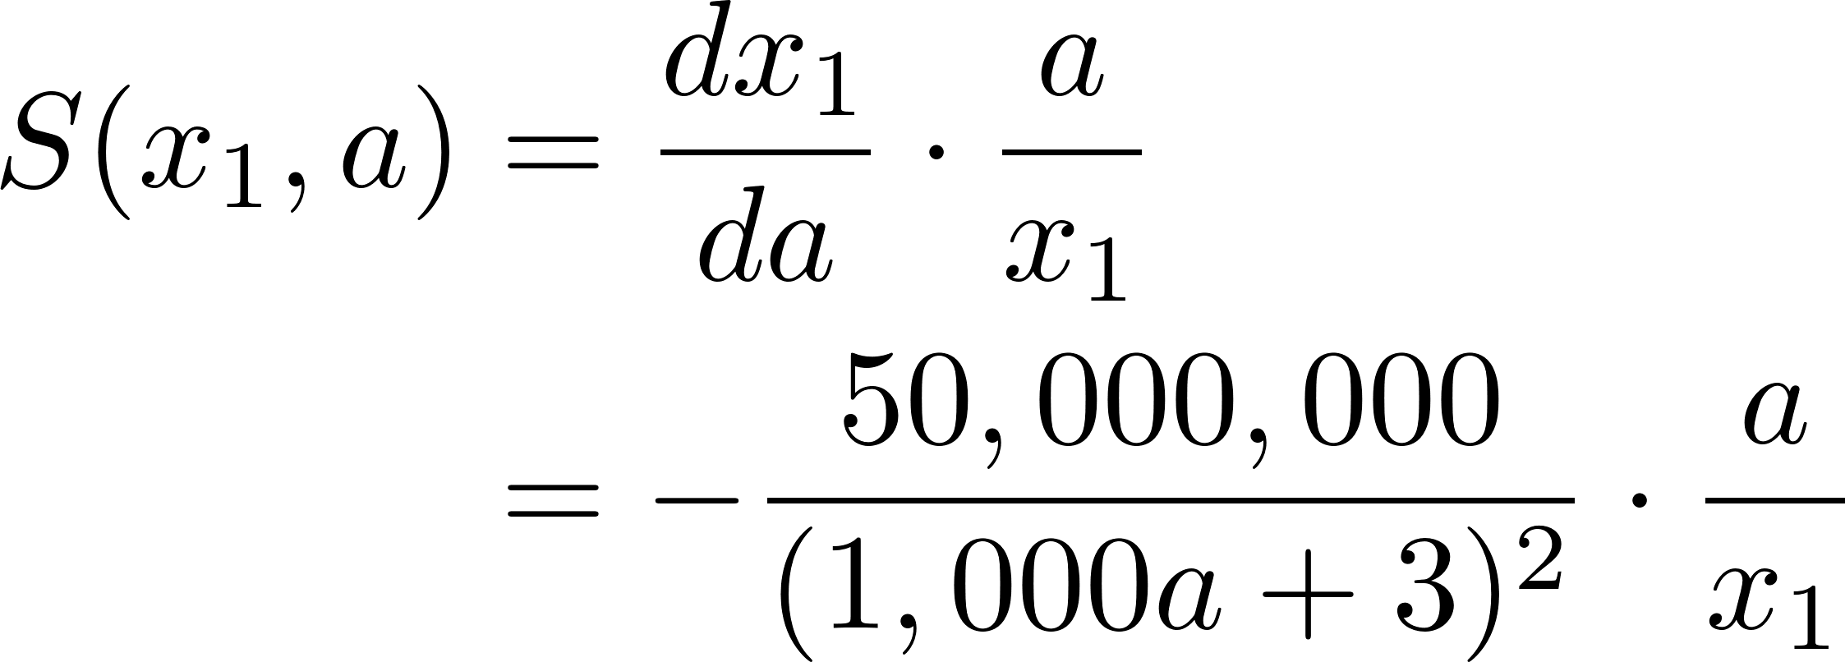

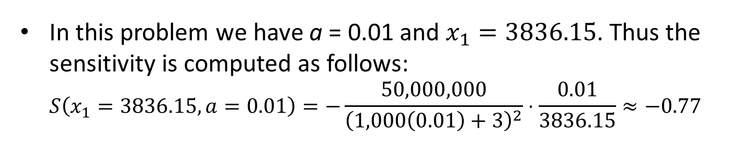

Sensitivity of $x_{1}$ to a
We left off with $x_{1}=\frac{50,000}{1000a+3}$
Thus,
In this problem we have a = 0.01 and $x_{1}=3836.15$. Thus the sensitivity is computed as follows: $S\left(x_{1}=3836.15,a=0.01\right)=−\frac{50,000,000}{{\left(1,000\left(0.01\right)+3\right)}^{2}}⋅\frac{0.01}{3836.15}≈−0.77$

Slide 8
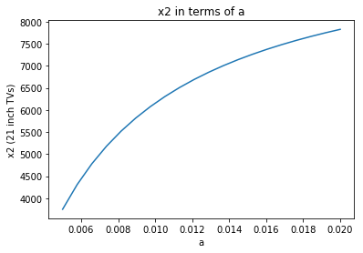
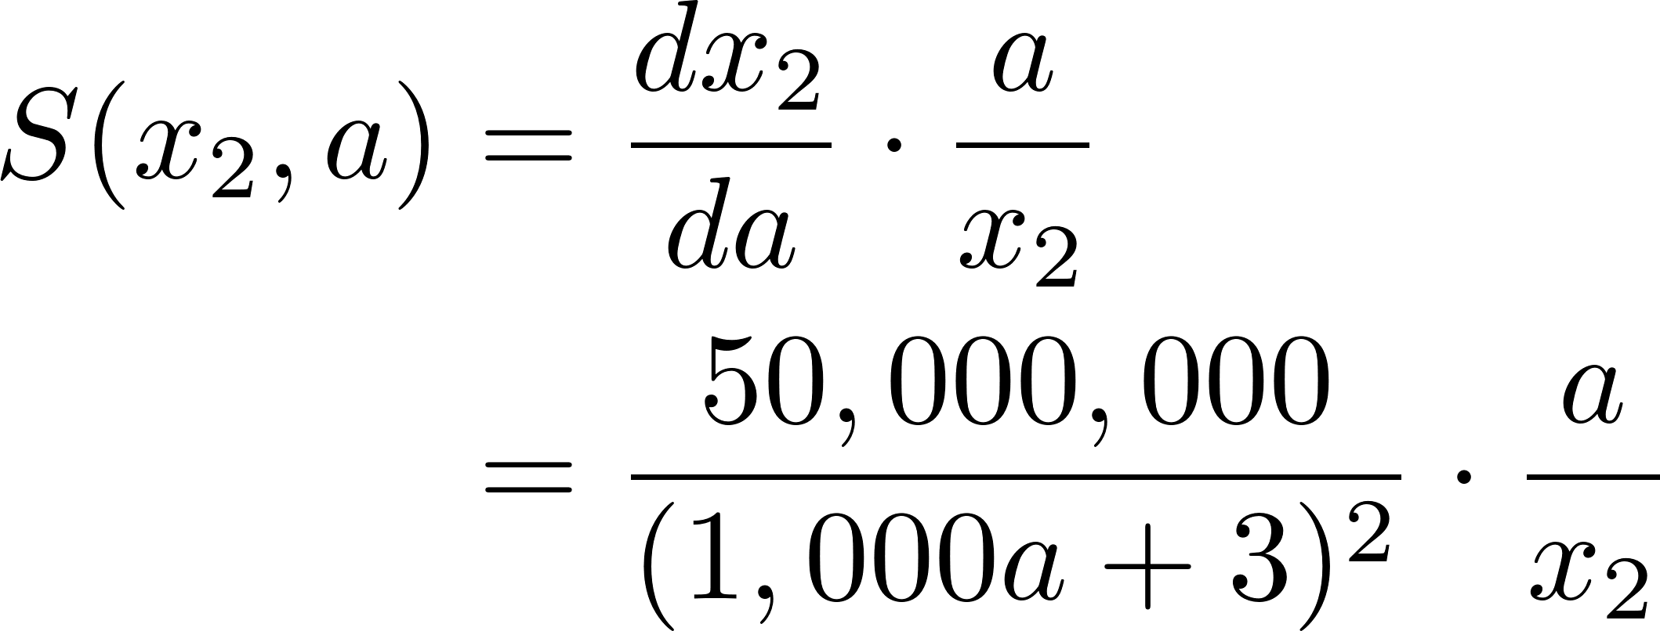

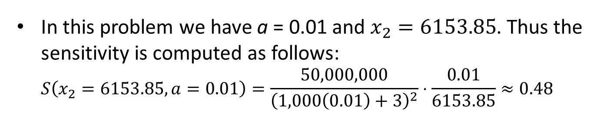

Sensitivity of $x_{2}$ to a
We have $x_{2}=\frac{20,000(500a − 1)}{1,000a +3}$
Thus,
In this problem we have a = 0.01 and $x_{2}=6153.85$. Thus the sensitivity is computed as follows: $S\left(x_{2}=6153.85,a=0.01\right)=\frac{50,000,000}{{\left(1,000\left(0.01\right)+3\right)}^{2}}⋅\frac{0.01}{6153.85}≈0.48$

Slide 9
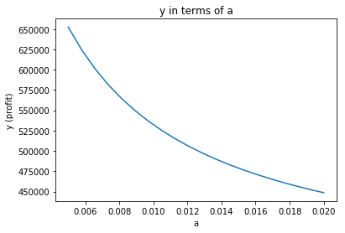
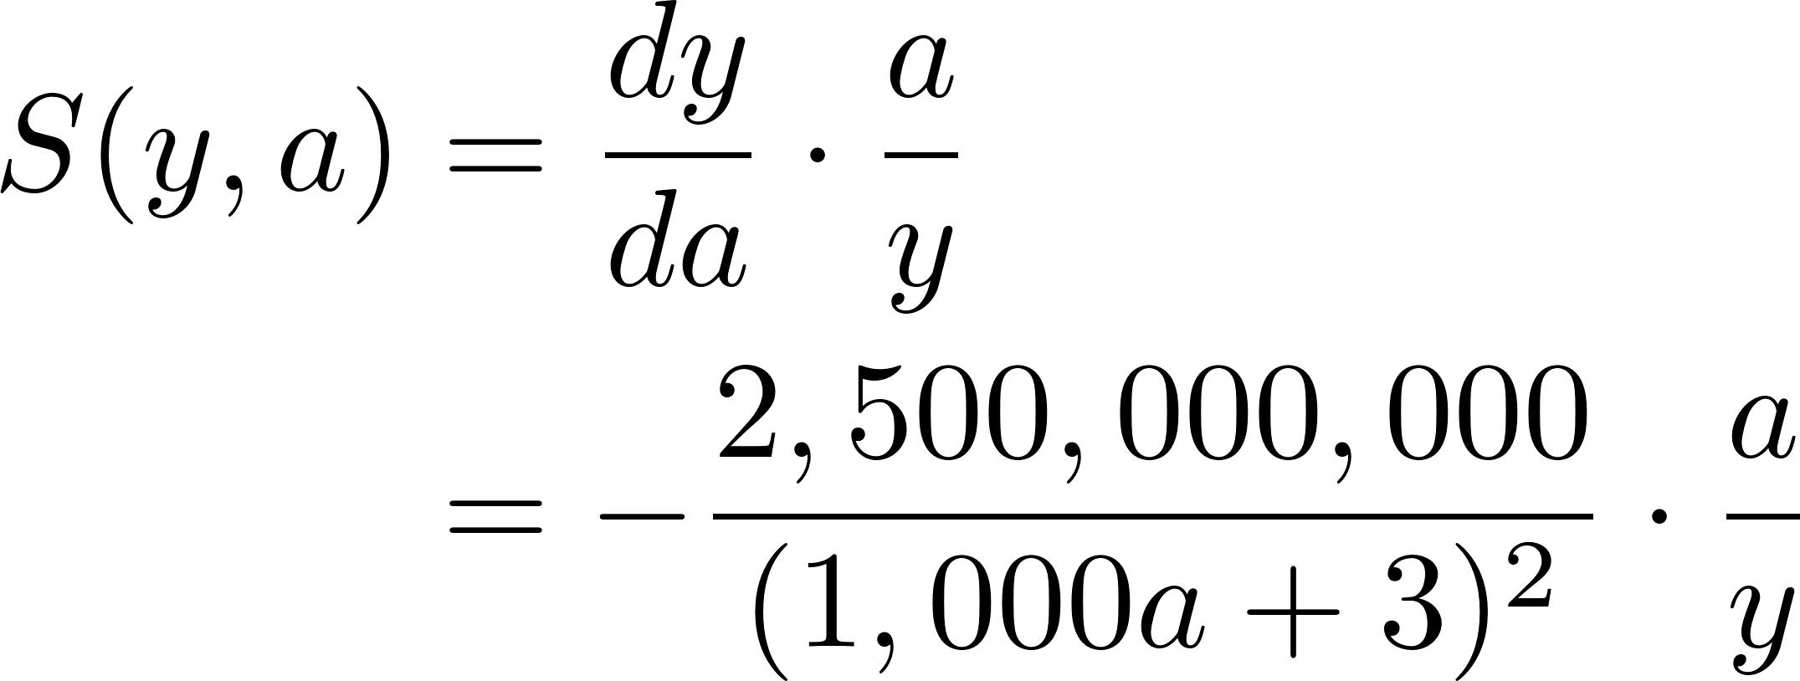

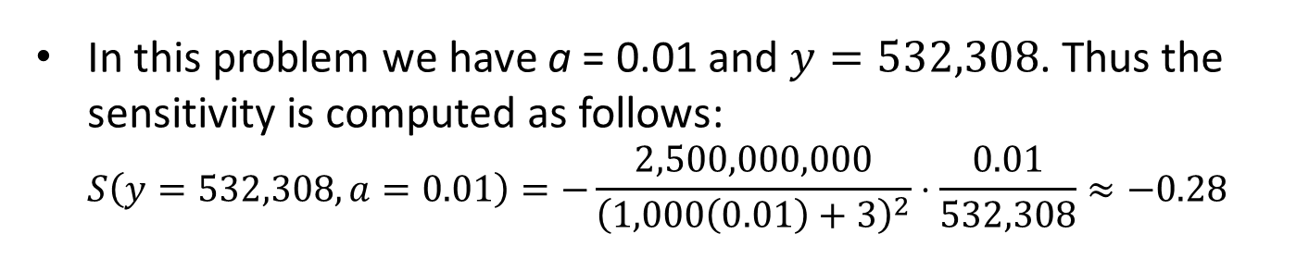

Sensitivity of $y$ to a
We have $y=\frac{160,000(2125a+22)}{1000a+3}$
Thus,
In this problem we have a = 0.01 and $y=532,308$. Thus the sensitivity is computed as follows: $S\left(y=532,308,a=0.01\right)=−\frac{2,500,000,000}{{\left(1,000\left(0.01\right)+3\right)}^{2}}⋅\frac{0.01}{532,308}≈−0.28$

Slide 10
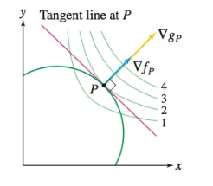

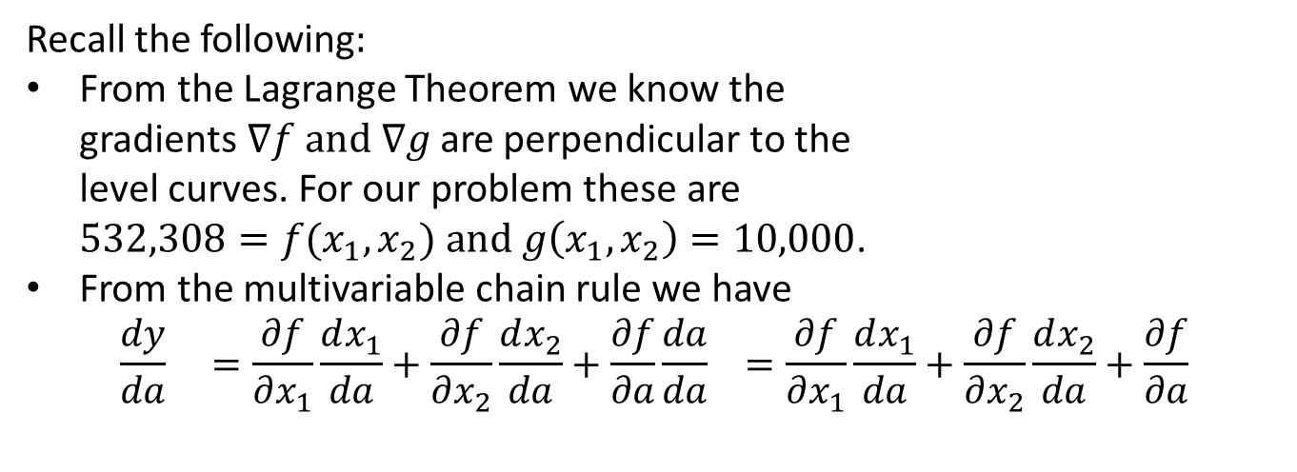
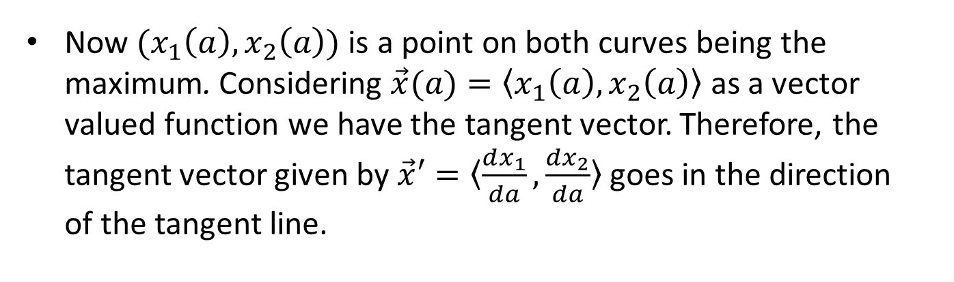
Sensitivity of $y$ to a: Another Approach
Recall the following$:$
From the Lagrange Theorem we know the gradients$∇f and ∇g$are perpendicular to the level curves. For our problem these are ${{532,308=f(x}_{1}, x}_{2}) and g\left(x_{1},x_{2}\right)=10,000$.
From the multivariable chain rule we have $\frac{dy}{da} =\frac{∂f}{∂x_{1}}\frac{dx_{1}}{da}+\frac{∂f}{∂x_{2}}\frac{dx_{2}}{da}+\frac{∂f}{∂a}\frac{da}{da} =\frac{∂f}{∂x_{1}}\frac{dx_{1}}{da}+\frac{∂f}{∂x_{2}}\frac{dx_{2}}{da}+\frac{∂f}{∂a}$
Now $(x_{1}\left(a\right), x_{2}\left(a\right))$ is a point on both curves being the maximum. Considering $\vec{x}(a)=〈x_{1}\left(a\right), x_{2}\left(a\right)〉$ as a vector valued function we have the tangent vector. Therefore, the tangent vector given by $\vec{x}′=〈\frac{dx_{1}}{da},\frac{dx_{2}}{da}〉$ goes in the direction of the tangent line.

Slide 11
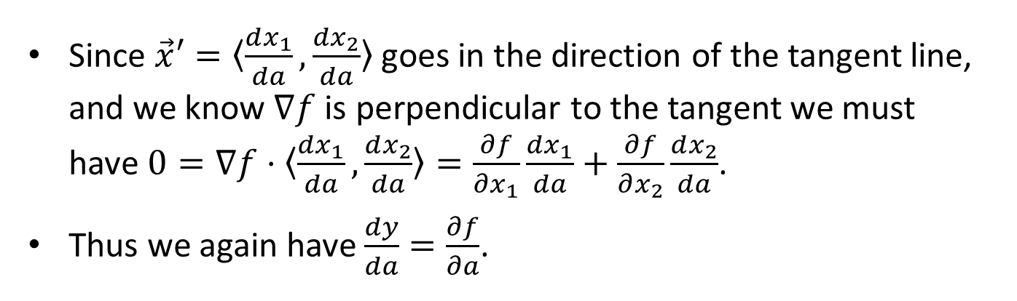
Sensitivity of $y$ to a: Another Approach
Recall the following$:$
From the Lagrange Theorem we know the gradients$∇f and ∇g$are perpendicular to the level curves. For our problem these are ${{532,308=f(x}_{1}, x}_{2}) and g\left(x_{1},x_{2}\right)=10,000$.
From the multivariable chain rule we have $\frac{dy}{da} =\frac{∂f}{∂x_{1}}\frac{dx_{1}}{da}+\frac{∂f}{∂x_{2}}\frac{dx_{2}}{da}+\frac{∂f}{∂a}\frac{da}{da} =\frac{∂f}{∂x_{1}}\frac{dx_{1}}{da}+\frac{∂f}{∂x_{2}}\frac{dx_{2}}{da}+\frac{∂f}{∂a}$
Since $\vec{x}′=〈\frac{dx_{1}}{da},\frac{dx_{2}}{da}〉$ goes in the direction of the tangent line, and we know $∇f$ is perpendicular to the tangent we must have $0=∇f⋅〈\frac{dx_{1}}{da},\frac{dx_{2}}{da}〉=\frac{∂f}{∂x_{1}}\frac{dx_{1}}{da}+\frac{∂f}{∂x_{2}}\frac{dx_{2}}{da}$.
Thus we again have $\frac{dy}{da}=\frac{∂f}{∂a}$.

Slide 12

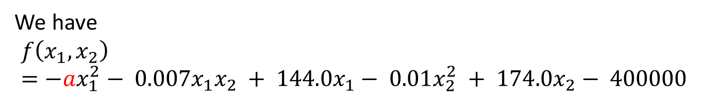
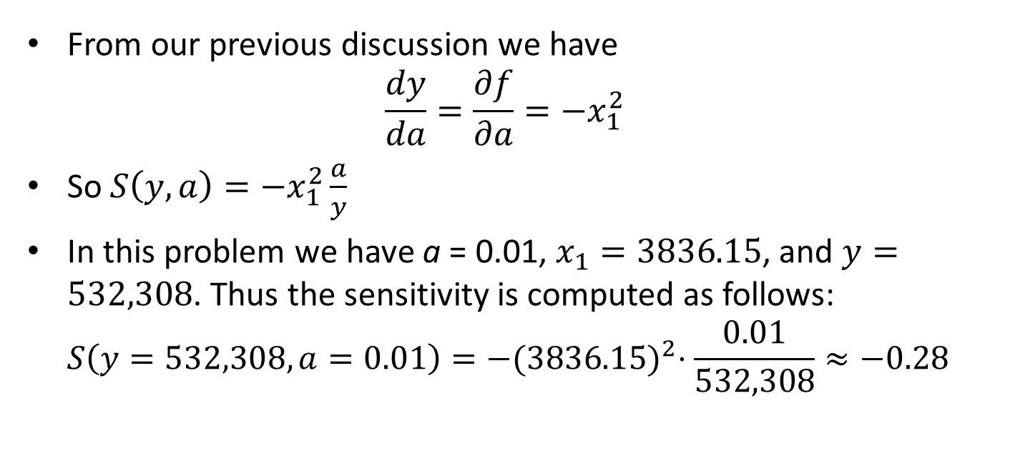
Sensitivity of $y$ to a: Again
We have $$f\left(x_{1},x_{2}\right)=−ax_{1}^{2}− 0.007x_{1}x_{2} + 144.0x_{1}− 0.01x_{2}^{2} + 174.0x_{2}− 400000$$
From our previous discussion we have $\frac{dy}{da}=\frac{∂f}{∂a}=−x_{1}^{2}$
So $S\left(y,a\right)=−x_{1}^{2}\frac{a}{y}$
In this problem we have a = 0.01, $x_{1}=3836.15$, and $y=532,308$. Thus the sensitivity is computed as follows: $S\left(y=532,308,a=0.01\right)=−{(3836.15)}^{2}⋅\frac{0.01}{532,308}≈−0.28$
Notes:
Note x_1 is also a function of a

Slide 13
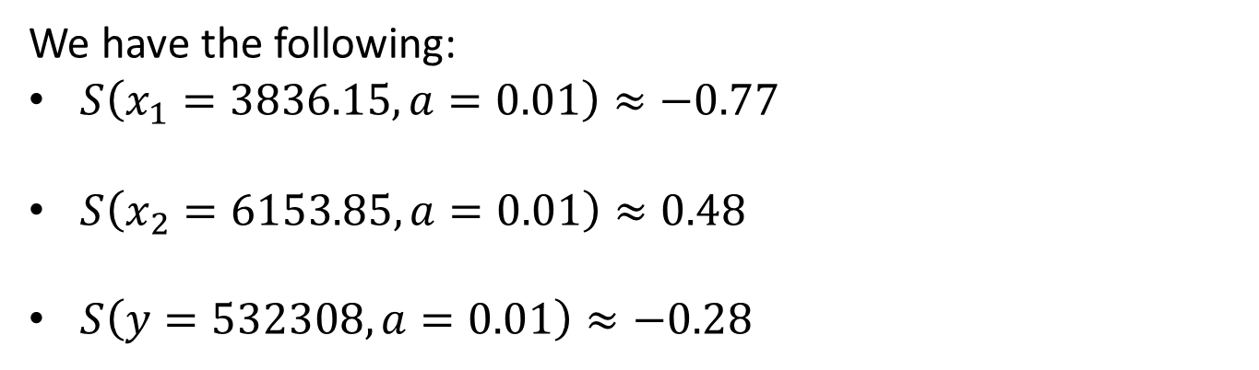
Sensitivity Interpretation
We have the following:
$S\left(x_{1}=3836.15,a=0.01\right)≈−0.77$
$S\left(x_{2}=6153.85,a=0.01\right)≈0.48$
$S\left(y=532308,a=0.01\right)≈−0.28$
Interpretation:
If the price elasticity for the 19-inch sets were to increase by 10% then we should make 7.7% fewer 19-inch sets and 4.8% more 21-inch sets. The resulting profit would decrease by 2.8%.

Slide 14
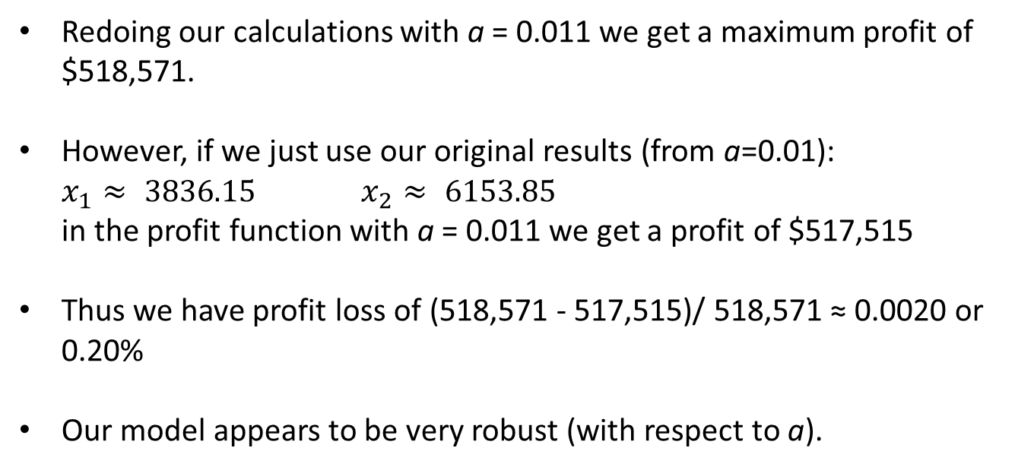
Robustness with respect to a
Suppose we are 10% off on our estimation of a = 0.01. So, really a = 0.011.
Redoing our calculations with a = 0.011 we get a maximum profit of $518,571.
However, if we just use our original results (from a=0.01): $x_{1}≈ 3836.15$ $x_{2}≈ 6153.85$ in the profit function with a = 0.011 we get a profit of $517,515
Thus we have profit loss of (518,571 - 517,515)/ 518,571 ≈ 0.0020 or 0.20%
Our model appears to be very robust (with respect to a).

Slide 15
Shadow Prices
For maximization problems constraints can often be thought of as restrictions on the amount of resources available, and the objective can be thought of as profit.
The shadow price associated with a particular constraint tells you how much the optimal value of the objective would increase per unit increase in the amount of resources available. In other words, the shadow price associated with a resource tells you how much more profit you would get by increasing the amount of that resource by one unit.
Parameters (Constraints):
5000 – max number of 19 inch sets (resource: circuit board)
8000 – max number of 21 inch sets (resource: circuit board)
10000 – combine max number of TV sets that can be produced (resource: capacity)

Slide 16
Price Elasticity for Production Capacity
Parameters (Constraints):
5000 – max number of 19 inch sets (resource: circuit board)
8000 – max number of 21 inch sets (resource: circuit board)
c – combine max number of TV sets that can be produced (resource: capacity).
We will per form sensitivity analysis on the amount of capacity available for TV production, calling this parameter c. Along the way we will compute and discuss the shadow price for production capacity.
We now examine how this changes the model, again using Lagrange multipliers.

Slide 17
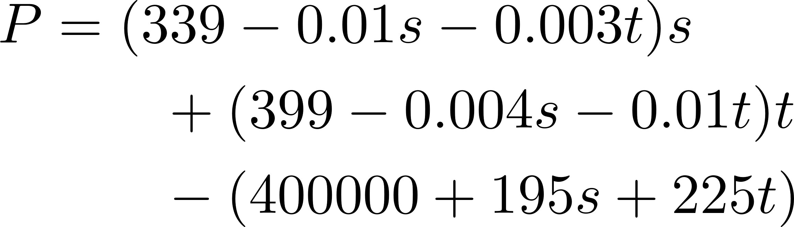
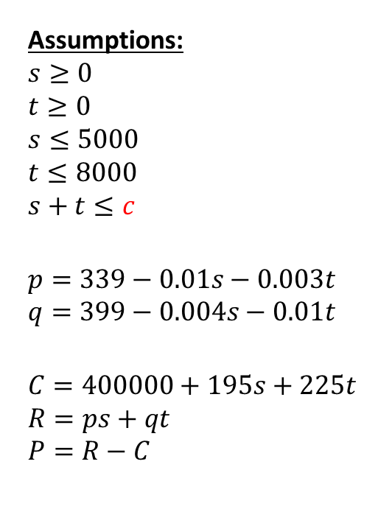
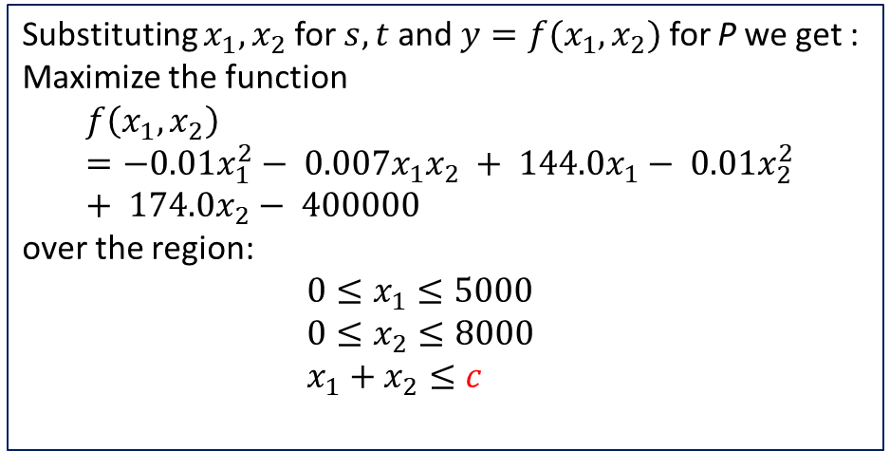
Updated Model
Assumptions:
$$s≥0$$
$$t≥0$$
$$s≤5000$$
$$t≤8000$$
$$s+t≤c$$
$$p=339−0.01s−0.003t$$
$$q=399−0.004s−0.01t$$
$$C=400000+195s+225t \\ R=ps+qt \\ P=R−C$$
Maximize:
Substituting $x_{1},x_{2}$ for $s,t$ and ${y=f(x}_{1},x_{2})$ for P we get : Maximize the function
$$f\left(x_{1},x_{2}\right)=−0.01x_{1}^{2}− 0.007x_{1}x_{2} + 144.0x_{1}− 0.01x_{2}^{2} + 174.0x_{2}− 400000$$
over the region:
$0≤x_{1}≤5000$
$0≤x_{2}≤8000$
$x_{1}+x_{2}≤c$

Slide 18
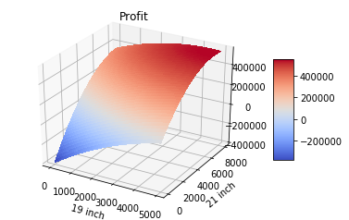
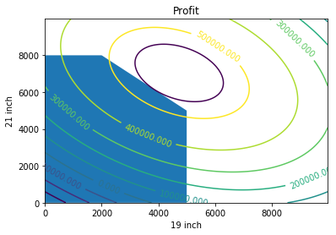
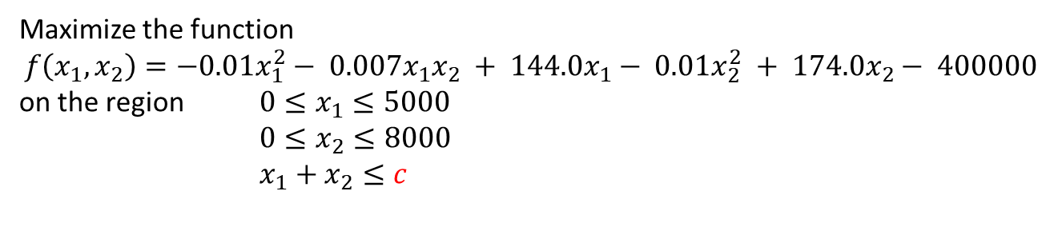
Updated Model
Maximize the function
$$f\left(x_{1},x_{2}\right)=−0.01x_{1}^{2}− 0.007x_{1}x_{2} + 144.0x_{1}− 0.01x_{2}^{2} + 174.0x_{2}− 400000$$
on the region $0≤x_{1}≤5000$
$0≤x_{2}≤8000$
$x_{1}+x_{2}≤c$
feasible region – changes as c changes
Notes:
Based on the picture it appears the maximum is at the intersection of the purple contour and the region.

Slide 19
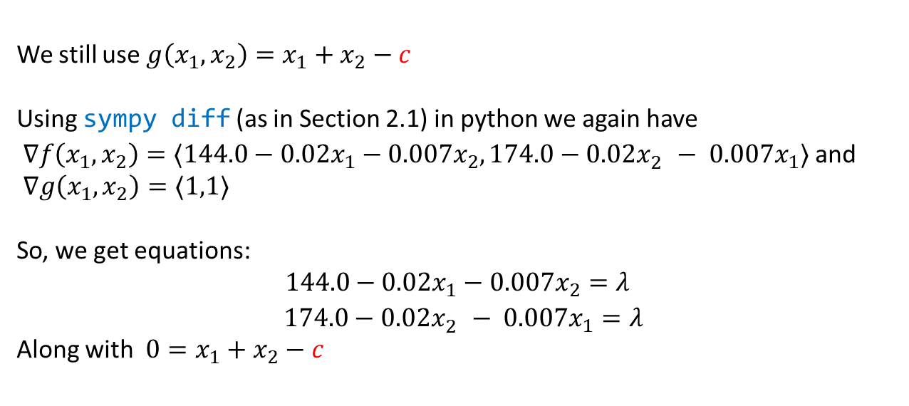
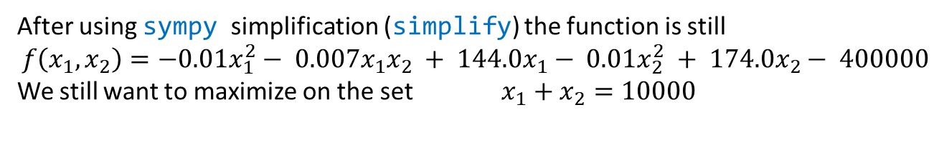
Reexamining Calculations
After using sympy simplification (simplify) the function is still
$$f\left(x_{1},x_{2}\right)=−0.01x_{1}^{2}− 0.007x_{1}x_{2} + 144.0x_{1}− 0.01x_{2}^{2} + 174.0x_{2}− 400000$$
We still want to maximize on the set $x_{1}+x_{2}=10000$
We still use ${g\left(x_{1},x_{2}\right)=x}_{1}+x_{2}−c$
Using sympy diff (as in Section 2.1) in python we again have
$∇f\left(x_{1},x_{2}\right)=〈144.0−0.02x_{1}−0.007x_{2},174.0−0.02x_{2}^{}− 0.007x_{1}〉$ and
$∇g\left(x_{1},x_{2}\right)=〈1,1〉$
So, we get equations:
$$144.0−0.02x_{1}−0.007x_{2}=λ$$
$174.0−0.02x_{2}^{}− 0.007x_{1}=λ$
Along with ${0=x}_{1}+x_{2}−c$

Slide 20
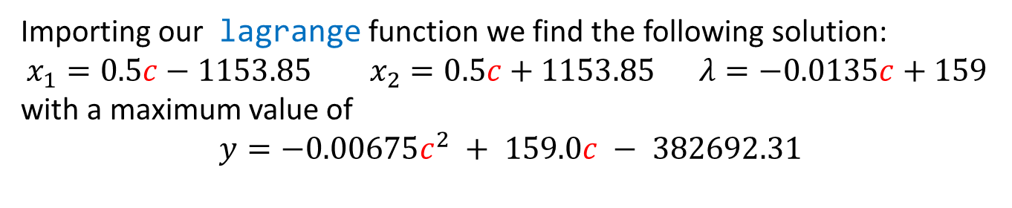
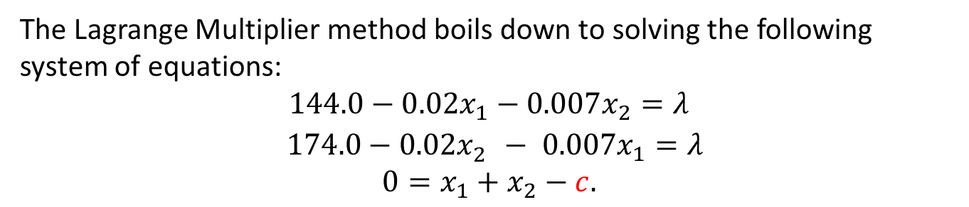
Reexamining Calculations: Lagrange
The Lagrange Multiplier method boils down to solving the following system of equations:
$$144.0−0.02x_{1}−0.007x_{2}=λ$$
$174.0−0.02x_{2}^{}− 0.007x_{1}=λ$
$${0=x}_{1}+x_{2}−c.$$
Importing our lagrange function we find the following solution:
$$x_{1}=0.5c−1153.85 { x}_{2}=0.5c+1153.85 λ=−0.0135c+159$$
with a maximum value of
$$y=−0.00675c^{2} + 159.0c − 382692.31$$
Notes:
Note the use of nsymplify and simplify. The nsimplify makes all the numbers fractions, which can produce better results.

Slide 21
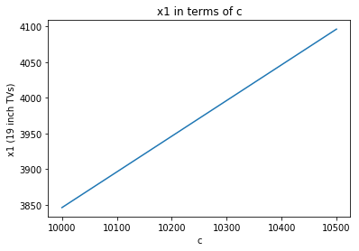
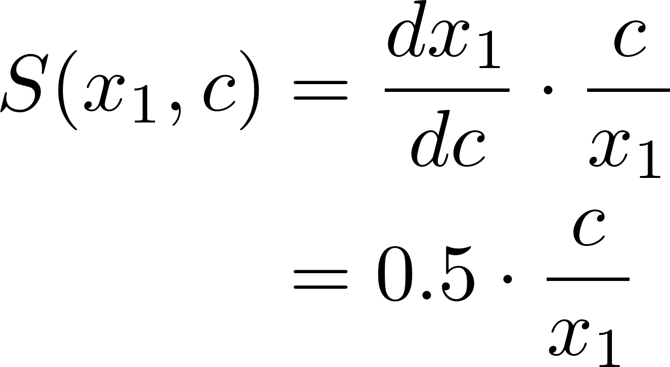
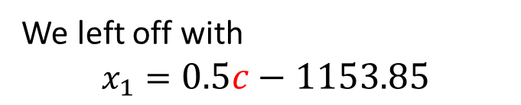
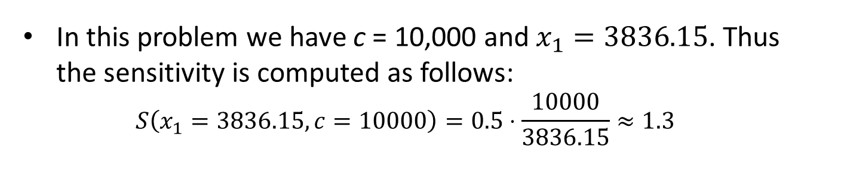

Sensitivity of $x_{1}$ to c
We left off with $$x_{1}=0.5c−1153.85$$
Thus,
In this problem we have c = 10,000 and $x_{1}=3836.15$. Thus the sensitivity is computed as follows: $S\left(x_{1}=3836.15,c=10000\right)=0.5⋅\frac{10000}{3836.15}≈1.3$

Slide 22
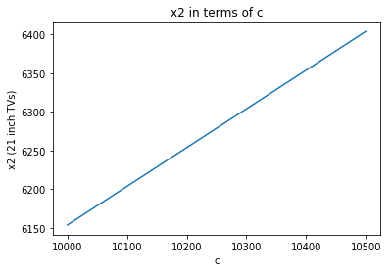
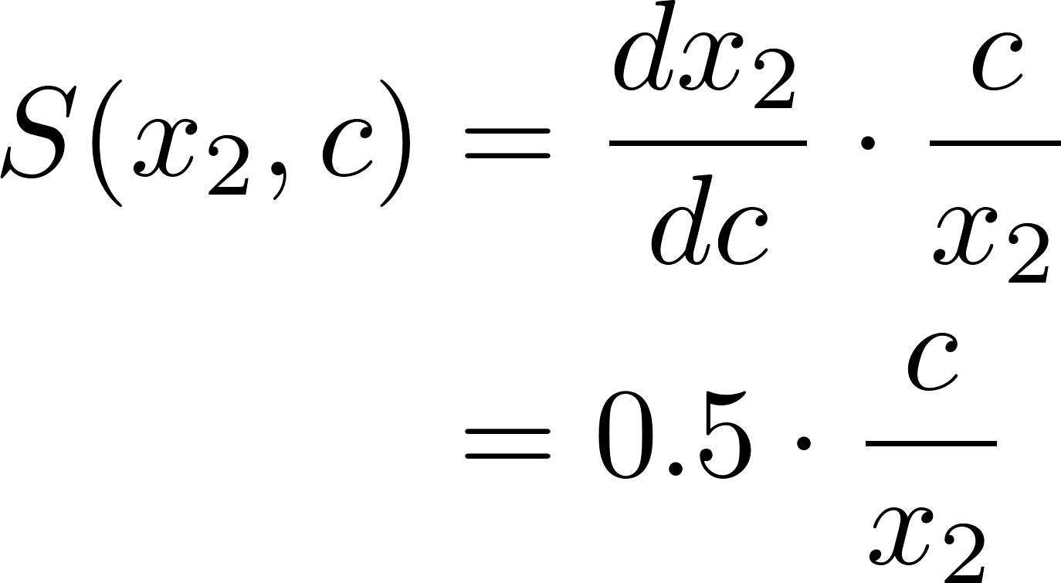
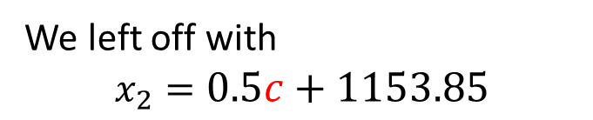
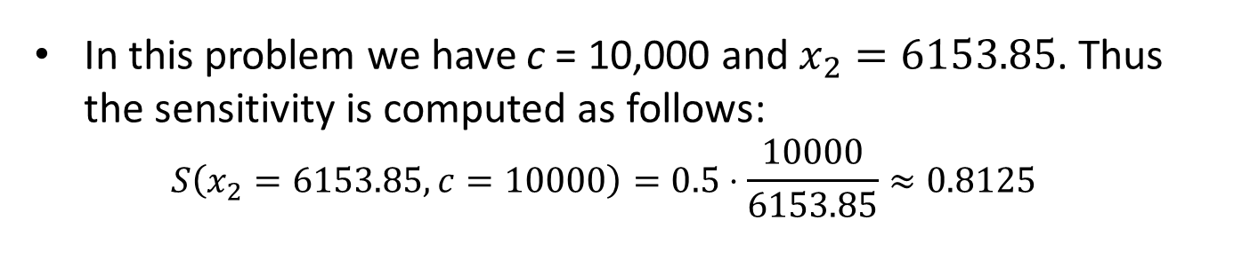

Sensitivity of $x_{2}$ to c
We left off with $$x_{2}=0.5c+1153.85$$
Thus,
In this problem we have c = 10,000 and $x_{2}=6153.85$. Thus the sensitivity is computed as follows: $S\left(x_{2}=6153.85,c=10000\right)=0.5⋅\frac{10000}{6153.85}≈0.8125$

Slide 23
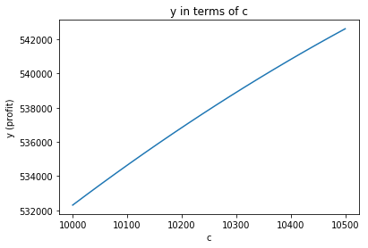
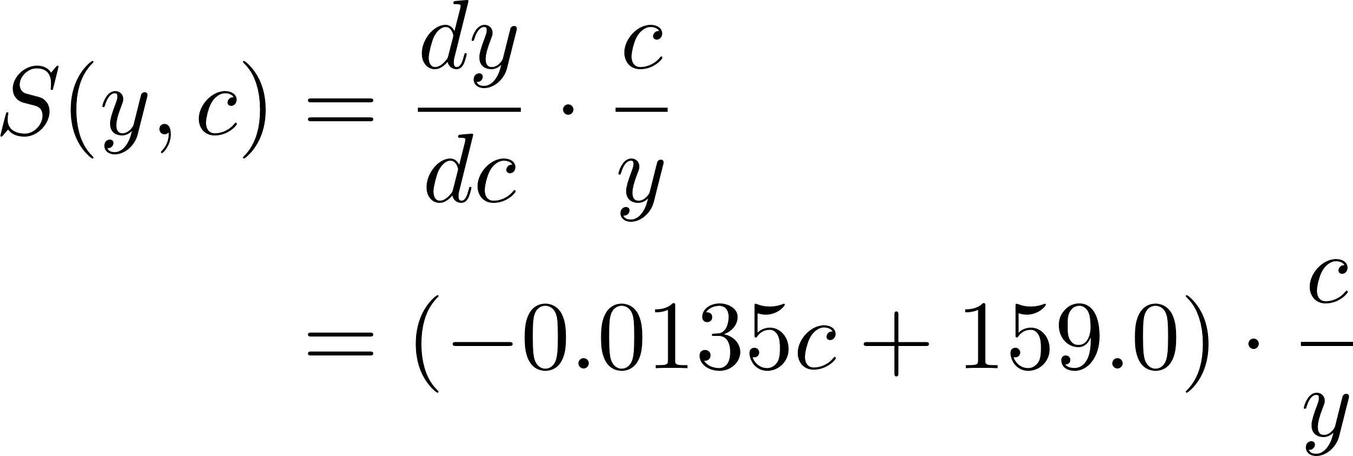
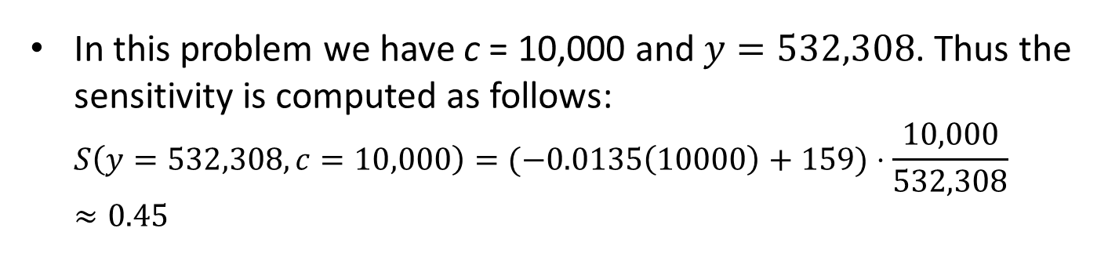

Sensitivity of $y$ to c
We have $y=−0.00675c^{2} + 159.0c − 382692.31$
Thus,
In this problem we have c = 10,000 and $y=532,308$. Thus the sensitivity is computed as follows: $S\left(y=532,308,c=10,000\right)=(−0.0135\left(10000\right)+159)⋅\frac{10,000}{532,308}≈0.45$

Slide 24


Sensitivity of $y$ to c: Another Approach
Recall the following: $$y=f\left(x_{1},x_{2}\right)=−0.01x_{1}^{2}− 0.007x_{1}x_{2} + 144.0x_{1}− 0.01x_{2}^{2} + 174.0x_{2}− 400000$$
with
$$x_{1}=0.5c−1153.85 { x}_{2}=0.5c+1153.85$$
So, really, y is a function of c, $y=f\left(x_{1}(c),x_{2}(c)\right)$, thus the multivariable chain rule applies. $\frac{dy}{dc} =\frac{∂f}{∂x_{1}}\frac{dx_{1}}{dc}+\frac{∂f}{∂x_{2}}\frac{dx_{2}}{dc}$
Clearly, $\frac{dx_{1}}{dc}=\frac{dx_{2}}{dc}=0.5$
Recall also that from the in using Lagrange multipliers we have that $\frac{∂f}{∂x_{1}}=\frac{∂f}{∂x_{2}}=λ$

Slide 25
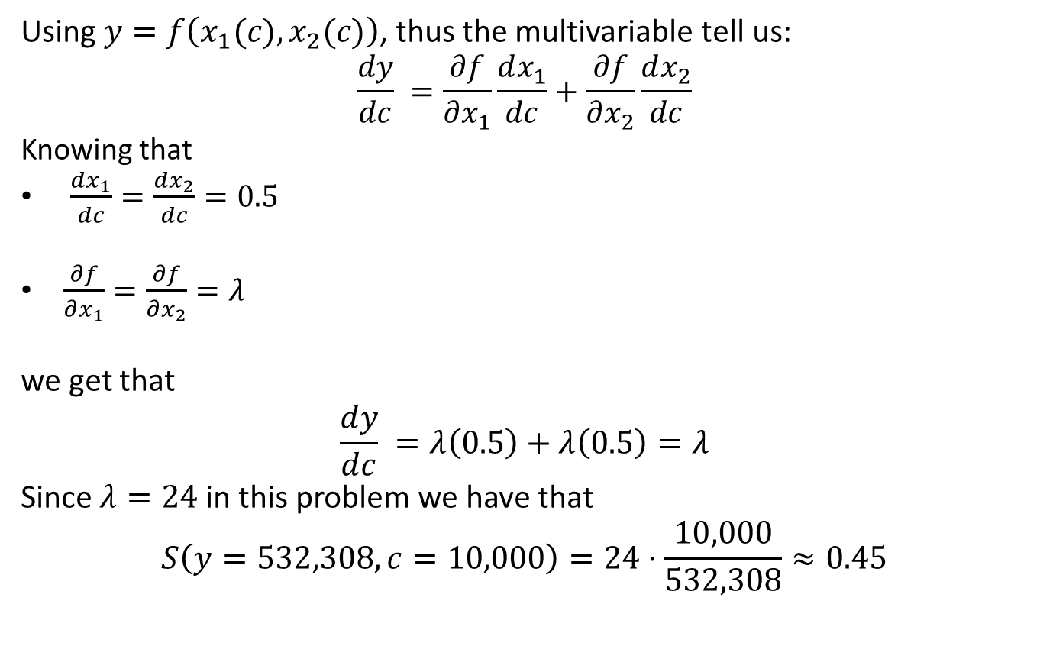
Sensitivity of $y$ to c: Another Approach
Using $y=f\left(x_{1}(c),x_{2}(c)\right)$, thus the multivariable tell us: $$\frac{dy}{dc} =\frac{∂f}{∂x_{1}}\frac{dx_{1}}{dc}+\frac{∂f}{∂x_{2}}\frac{dx_{2}}{dc}$$
Knowing that
$\frac{dx_{1}}{dc}=\frac{dx_{2}}{dc}=0.5$
$\frac{∂f}{∂x_{1}}=\frac{∂f}{∂x_{2}}=λ$
we get that
$$\frac{dy}{dc} =λ\left(0.5\right)+λ\left(0.5\right)=λ$$
Since $λ=24$ in this problem we have that
$$S\left(y=532,308,c=10,000\right)=24⋅\frac{10,000}{532,308}≈0.45$$

Slide 26
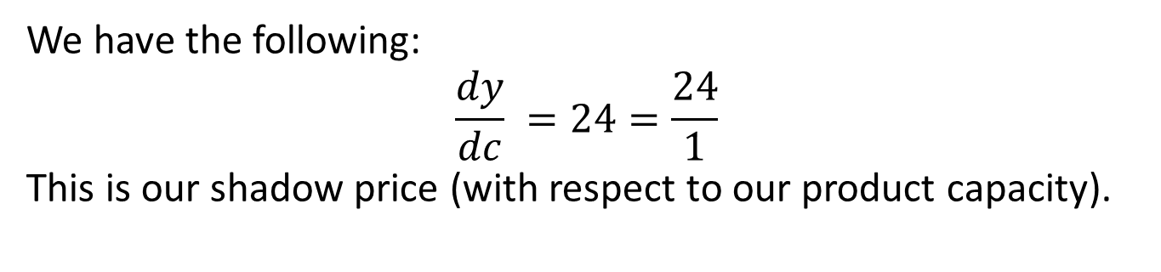
Shadow Price
We have the following:
$$\frac{dy}{dc} =24=\frac{24}{1}$$
This is our shadow price (with respect to our product capacity).
Interpretation:
The addition of 1 unit of production capacity (c) results in an increased profit (y) of $24.
That is, the company should be willing to pay up to $24 per unit to increase the production capacity.

Slide 27

Sensitivity Interpretation
We have the following:
$S\left(x_{1}=3836.15,c=10,000\right)≈1.3$
$S\left(x_{2}=6153.85,c=10,000\right)≈0.8$
$S\left(y=532308,c=10,000\right)≈0.45$
Interpretation:
If the price elasticity for the production capacity were to increase by 10% then we should make 13% more 19-inch sets and 8% more 21-inch sets. The resulting profit would increase by 4.5%.
Notes:
This makes sense…upping capacity will allow us to make more TV’s and increase prices.
Also, there is no need to do robustness analysis on this as the value of 10,000 should be exactly known by the company

Slide 28
Binding Constraints
Parameters (Constraints):
5000 – max number of 19 inch sets (resource: circuit board)
8000 – max number of 21 inch sets (resource: circuit board)
10000 – combine max number of TV sets that can be produced (resource: capacity)
binding constraint – small changes to the constraint cause changes to the optimal solution
nonbinding constraint – small changes to the constraint do not affect the optimal solution
Which of the constraints are binding/nonbinding?
Notes:
Binding – production capacity
Nonbinding – max circuit boards….we are nowhere near those values…our optimum is (3,846,6154)…changing these some will not alter things

